Slide 1
S2 Z3

Slide 2

Design Patterns

Slide 3


Slide 4


Slide 5
Design Patterns
Modules x3
Singleton x2
Factory x2
Decorator x4

Slide 6
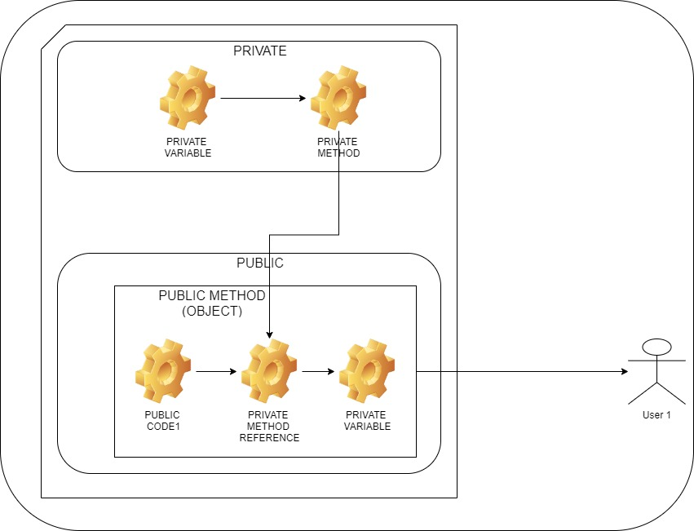

Slide 7
Module / Closure
const myModule = (function() {
const privateVariable = "Hello World";
function privateMethod() {
console.log(privateVariable);
}
return {
publicMethod: function() {
console.log("publicMethod start");
privateMethod();
console.log("publicMethod end");
}
};
})();
console.log(myModule);
myModule.publicMethod();
publicMethod start
Hello World
publicMethod end

Slide 8
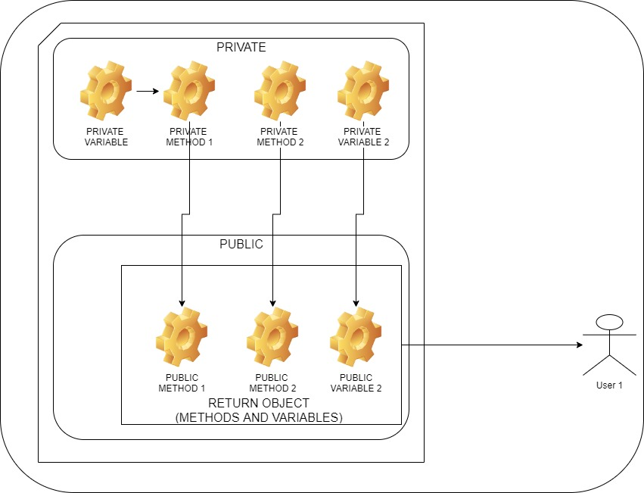

Slide 9
Revealing Module ½ (definition)
const myRevealingModule = (function() {
let privateVar = "Peter";
const publicVar = "Hello World";
function privateFunction() {
console.log("Name: " + privateVar);
}
function publicSetName(name) {
privateVar = name;
}
function publicGetName() {
privateFunction();
}
return {
setName: publicSetName,
greeting: publicVar,
getName: publicGetName
};
})();

Slide 10
Revealing Module 2/2 (usage)
console.log(myRevealingModule);
myRevealingModule.setName("Mark");
myRevealingModule.getName();
Name: Mark

Slide 11
ES6 Module 1/3 (definition)
const greeting = "Hello World";
let callCounter = 0;
function sayHelloFirstTime() {
if (callCounter++ === 0) {
console.log(greeting);
}
}
function privateLog() {
console.log("Private Function");
}
function multiply(num1, num2) {
sayHelloFirstTime();
console.log("Multiply:", num1, num2);
return num1 * num2;
}

Slide 12
ES6 Module 2/3 (definition)
function subtract(num1, num2) {
sayHelloFirstTime();
console.log("Subtract:", num1, num2);
return num1 - num2;
}
module.exports = {
sum: sum,
subtract: subtract,
multiply: multiply,
divide: divide
};

Slide 13
ES6 Module 3/3 (usage)
let mathUtils = require("./utils/utils");
console.log(mathUtils);
console.log(mathUtils.sum(3, 7));
console.log(mathUtils.subtract(3, 7));
console.log(mathUtils.multiply(3, 7));
console.log(mathUtils.divide(3, 7));

Slide 14
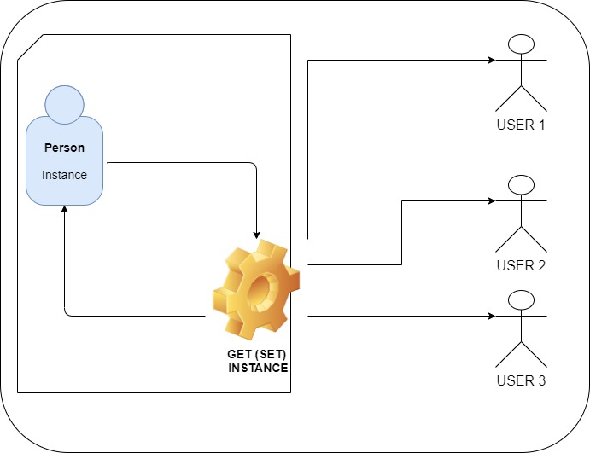

Slide 15
Singleton
function User() {
this.name = "Peter";
this.age = 25;
}
const user1 = new User();
const user2 = new User();
console.log(user1 === user2);
false

Slide 16
Singleton
let instance = null;
function User() {
if (instance) {
return instance;
}
instance = this;
this.name = "Peter";
this.age = 25;
return instance;
}
const user1 = new User();
const user2 = new User();
console.log(user1 === user2);
true

Slide 17
Singleton
const singleton = (function() {
let instance;
function init() {
return {
name: "Peter",
age: 24
};
}
return {
getInstance: function() {
if (!instance) {
instance = init();
}
return instance;
}
};
})();
const instanceA = singleton.getInstance();
const instanceB = singleton.getInstance(); console.log(instanceA === instanceB);
true

Slide 18
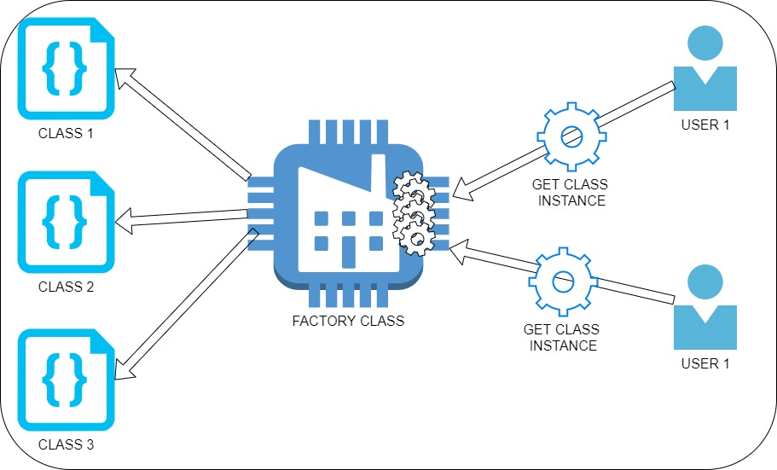

Slide 19
Factory Basic ½ (definition)
class Car {
constructor(options) {
this.doors = options.doors || 4;
this.state = options.state || "brand new";
this.color = options.color || "white";
}
}
class Truck {
constructor(options) {
this.doors = options.doors || 4;
this.state = options.state || "used";
this.color = options.color || "black";
}
}
class VehicleFactory {
createVehicle(options) {
if (options.vehicleType === "car") {
return new Car(options);
} else if (options.vehicleType === "truck") {
return new Truck(options);
}
}
}

Slide 20
Factory Basic 2/2 (usage)
const factory = new VehicleFactory();
const car = factory.createVehicle({
vehicleType: "car",
doors: 4,
color: "silver",
state: "Brand New"
});
const truck = factory.createVehicle({
vehicleType: "truck",
doors: 2,
color: "white",
state: "used"
});
console.log(car);
console.log(truck);
Car {doors: 4, state: "Brand New", color: "silver"}
Truck {doors: 2, state: "used", color: "white"}

Slide 21
Factory Advanced 1/3 (objects definition)
class Vehicle {
constructor(vehicleType) {
this.vehicleType = vehicleType;
}
}
class Car extends Vehicle {
constructor(options) {
super(options.vehicleType);
this.doors = options.doors || 4;
this.state = options.state || "brand new";
this.color = options.color || "white";
}
}
class Truck extends Vehicle {
constructor(options) {
super(options.vehicleType);
this.doors = options.doors || 4;
this.state = options.state || "used";
this.color = options.color || "black";
}
}

Slide 22
Factory Advanced 2/3 (factory definition)
class VehicleFactory {
createVehicle(options) {
if (options.vehicleType === "car") {
return new Car(options);
} else if (options.vehicleType === "truck") {
return new Truck(options);
}
}
}

Slide 23
Factory Advanced 3/3 (usage)
const factory = new VehicleFactory();
const car = factory.createVehicle({
vehicleType: "car",
doors: 4,
color: "silver",
state: "Brand New"
});
const truck = factory.createVehicle({
vehicleType: "truck",
doors: 2,
color: "white",
state: "used"
});
console.log(car);
console.log(truck);
Car {vehicleType: "car", doors: 4, state: "Brand New", color: "silver"}
Truck {vehicleType: "truck", doors: 2, state: "used", color: "white"}

Slide 24
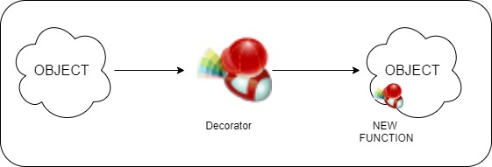

Slide 25
Decorator 1/3
class Car {
constructor() {
this.cost = function() {
return 20000;
};
this.desc = "basic";
}
}

Slide 26
Decorator 2/3
function carWithAC(car) {
car.hasAC = true;
const prevCost = car.cost();
car.cost = function() {
return prevCost + 500;
};
car.desc += " AC";
}
function carWithAutoTransmission(car) {
car.hasAutoTransmission = true;
const prevCost = car.cost();
car.cost = function() {
return prevCost + 2000;
};
car.desc += " AutoT";
}

Slide 27
Decorator 3/3
const car = new Car();
console.log(car.cost());
carWithAC(car);
carWithAutoTransmission(car);
console.log(car.cost());
console.log(car.desc);
console.log(car);
20000
22500
basic AC AutoT
Car {cost: , desc: "basic AC AutoT", hasAC: true, hasAutoTransmission: true}

Slide 28
Decorator
class Car {
constructor() {
this.cost = function() {
return 20000;
};
this.desc = "basic";
}
}
const car = new Car();
car.autoPark = () => console.log("Auto parking...");
console.log(car);
car.autoPark();
Car {cost: , desc: "basic", autoPark: }
Auto parking...

Slide 29
Decorator
class Car {
constructor() {
this.cost = function() {
return 20000;
};
this.desc = "basic";
}
}
function addParking(car) {
car.autoPark = () => console.log("Auto parking...");
}
const car = new Car();
addParking(car);
console.log(car);
car.autoPark();
Car {cost: , desc: "basic", autoPark: }
Auto parking...

Slide 30
Decorator
class Car {
constructor() {
this.cost = function() {
return 20000;
};
this.desc = "basic";
}
}
function addParking() {
Car.prototype.autoPark = () => console.log("Auto parking...");
}
const car = new Car();
addParking();
console.log(car);
car.autoPark();
Car {cost: , desc: "basic", autoPark: }
Auto parking...

